Slide 1
BETTER BIRTHS: COMMUNITY MATERNITY HUBS
Created with me not for me…..
What women & partners have told us so far

Slide 2
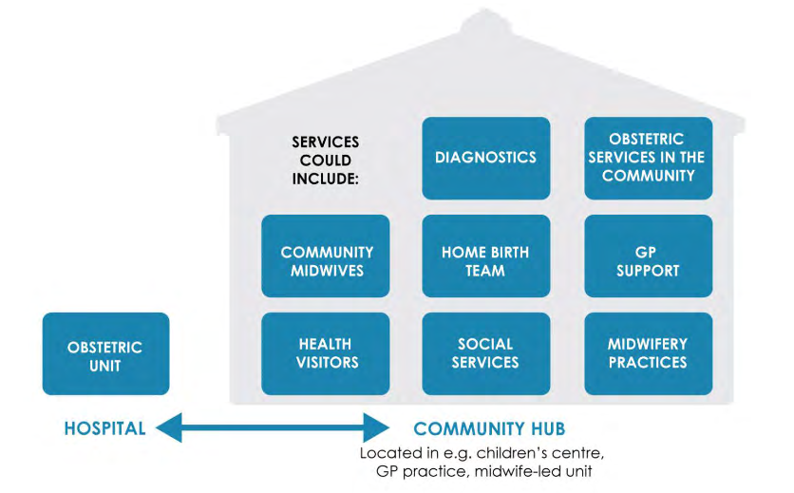
BETTER BIRTHS: COMMUNITY MATERNITY HUBS
OK – What is a hub? – National Maternity Review ‘Better Births’?
"Community Hubs we have already got that in a way - midwife antenatal clinics in GP practices“
“Where would they be?”
"It's like Helme Chase in a way"
“They sound good”
Notes:
West Cumbria Maternity Voices – Nat Maternity review concept began talking about this in

Slide 3
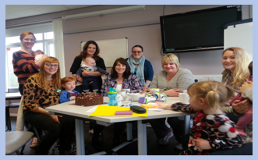
BETTER BIRTHS: COMMUNITY MATERNITY HUBS
Services
Breast feeding support - including in rural areas
Parentcraft
Baby Clinics
Parenting and baby workshops could be held in community hubs (ie. Baby Calm; yoga; massage; hypnobirthing)
Peer to Peer Support PNMH & B/F
Perinatal Mental Health services
Homebirth service ie. ‘1:1 Care’
" Maternity Hubs - with 1 birthing room with pool would be attractive"
Notes:
West Cumbria Maternity Voices Online Discussion Board – conversation about hubs picked up online, (where above comment received), and in Maternity Voices meetings, out in parent groups
Services that women and families said they would like designed into maternity hubs
umbria Service User – quote re – birthroom in hub WITH POOL
Breastfeeding Support – frequently mentioned - important service for community hubs– local support (concern over loss of b/f groups in rural and towns Egremont, Gosforth….)
There was some pragmatism about the fact that services such as scanning couldn’t be available in every location
Only one Mum spoke about ‘virtual’ hubs, majority envisioned physical hubs and were interested in where they would be.
Greater involvement likely when there are some tangible outline options to consider rather than a concept.

Slide 4
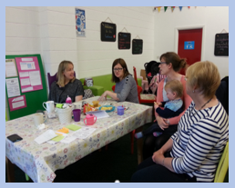
BETTER BIRTHS: COMMUNITY MATERNITY HUBS
Facilities & Environment
Bright, pleasant “somewhere you want to be”
Hot drinks available/ Comfortable social space for talking
Child friendly space/ Creche
Space for prams indoors
Easy access into build from car park
Welcoming Feeling
Space for parent groups
Birthing room with pool
Notes:
What it feels and looks like important – comfortable – and somewhere you want to be as a Mum or parent –
Twins and multiples group – talking about Community Hubs services and facilities

Slide 5
BETTER BIRTHS: COMMUNITY MATERNITY HUBS
Access & Location
“Needs to be near where you
live”.
"Parking is always an issue! Parking at GP surgeries mostly poor, if maternity hubs had good parking access that would be an improvement & encourage use.”
Free parking
Wouldn’t want to see all hubs in a Hospital, should be a mix
“you can get there and use service you need without the getting there taking up a big chunk of your morning or afternoon”
Local
Need to be able to get in and out of a Community Hub easily.
For those travelling by bus building needs to be convenient to bus stop.
For car users Car park close to entrance to building important for some families.
Notes:
West Cumbria Twins and Multiples Group: Access for parents of twins is a consideration – larger buggies, harder for a single person to carry/ lift car seats, and buggies down steps etc, in out of car, on off bus, and harder to keep eye on young toddler children.
Local is important, if they are to be a drop in resource.
Mums spoke of b/f group services not used because access difficult
Parking big item for women and families and related to usage of service.
Cost a factor too

Slide 6
BETTER BIRTHS: COMMUNITY MATERNITY HUBS
“I would love a community hub to be developed in my area (Cockermouth) and others in Cumbria. I think it would be most successful if coordinated and consulted through the teams based with community midwives, health visitors, NCT and MSLC.”
“It would work best at the Cockermouth Community Hospital, as this is were the community midwives are based and a number of GP surgeries; there is also ample parking for easy access with children.”
“Breastfeeding support, ultrasounds (for reduced travel to Whitehaven), play/activity area for my other small children so that the experience is more supportive of my needs.”
“I am not aware of this coordinated support yet in my area, but individually the community midwives, health visitors etc are superb. However I had VERY little breastfeeding support via the NHS.”
Notes:
Via on-line discussion group here is One Mum’s vision of a local Community Maternity Hub and how it could improve her experience of care.
??Mention about the Powys Maternity Hubs – strong relational based care with team of midwives….??

